Slide 1
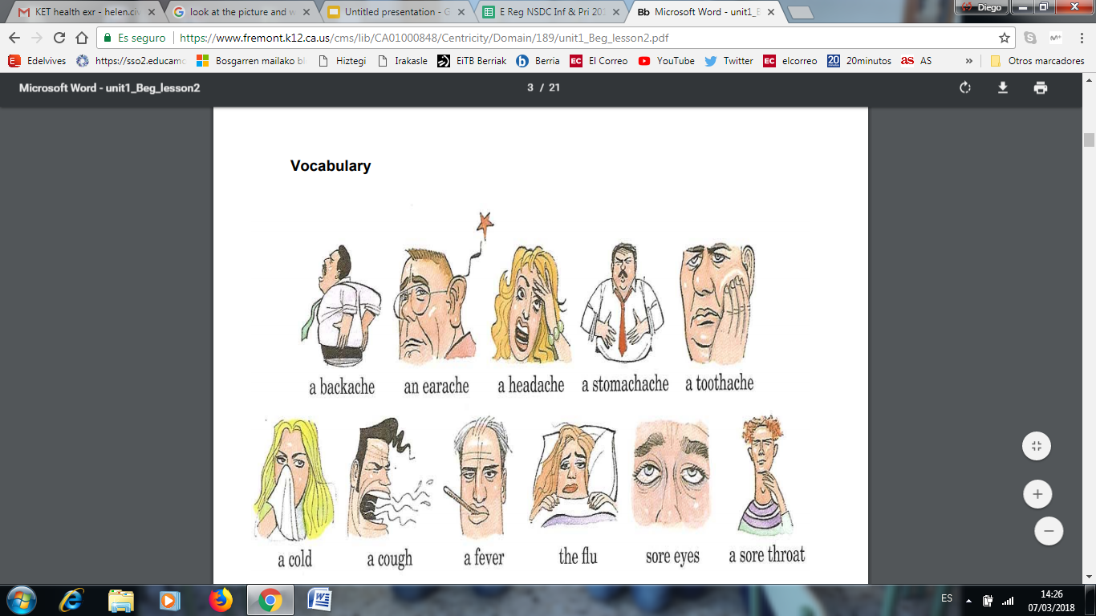

Slide 2


medicine
injection

Slide 3


headache
pills

Slide 4

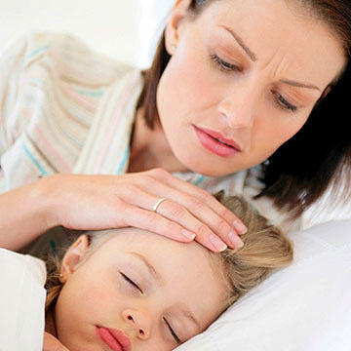
flu
fever

Slide 5
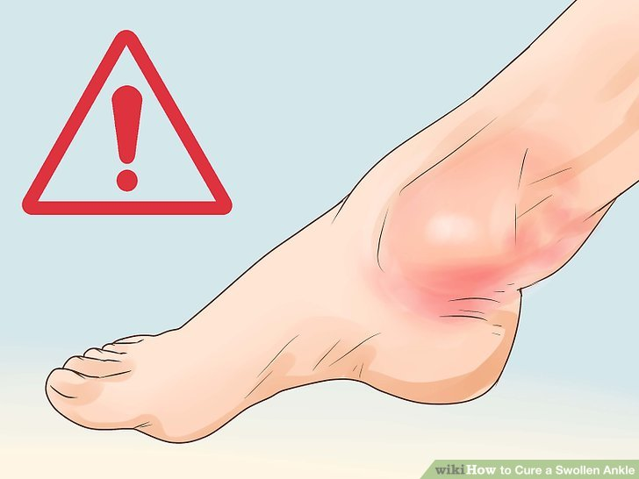
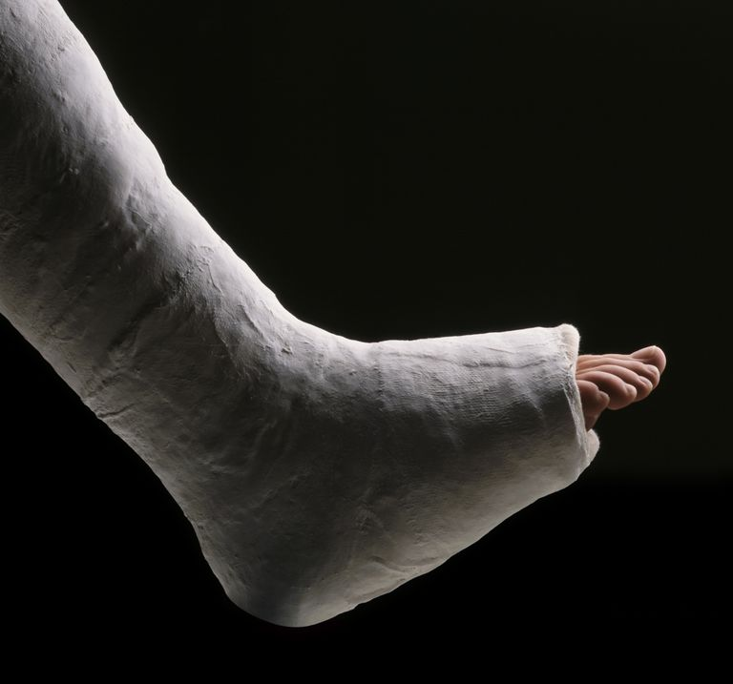
swollen
broken leg

Slide 6


cold
cough

Slide 7
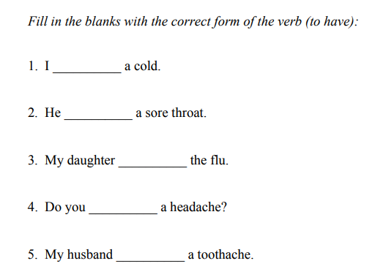
HAVE
HAS
HAS
HAVE
HAS

Slide 8
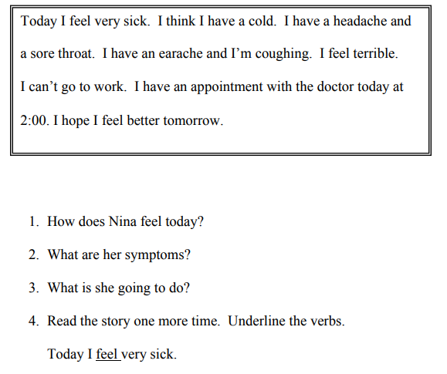

Slide 9


Slide 10
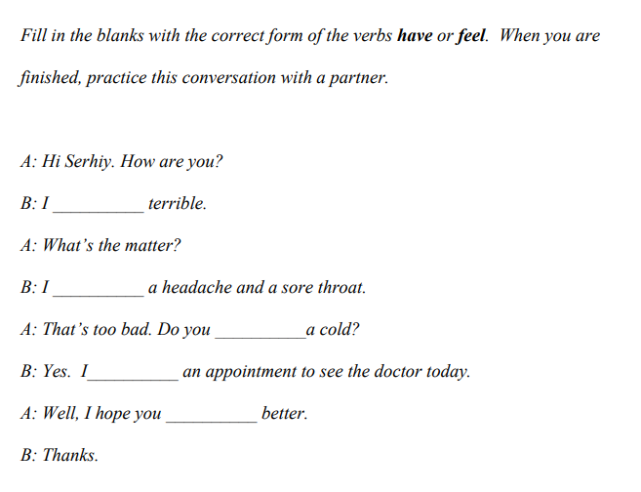
Jenny.
feel
have
have
have
feel

Slide 11
The part of the body that connects the head and the body
n_ _ _
The end of the leg, below the ankle joint, on which the body stands and moves
f_ _ _
People phone to ask this to take them to hospital
a _ _ _ _ _ _ _ _
eck
oot
mbulance

Slide 12
4. A pain located in the head
h _ _ _ _ _ _ _
5. Exhausted
t _ _ _ _
6. Feeling pain in your throat, having difficulty to speak and swallow
s _ _ _ t _ _ _ _ _
eadache
tired
ore
hroat

Slide 13
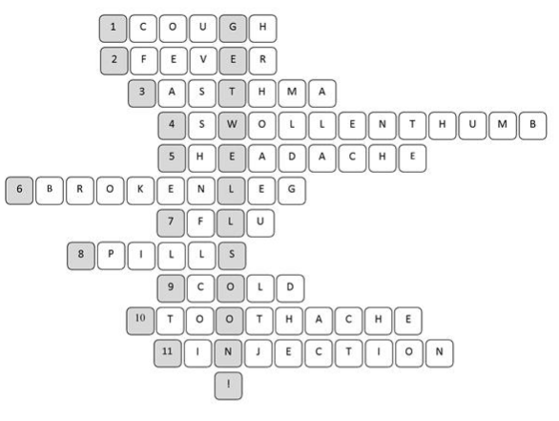

Slide 14
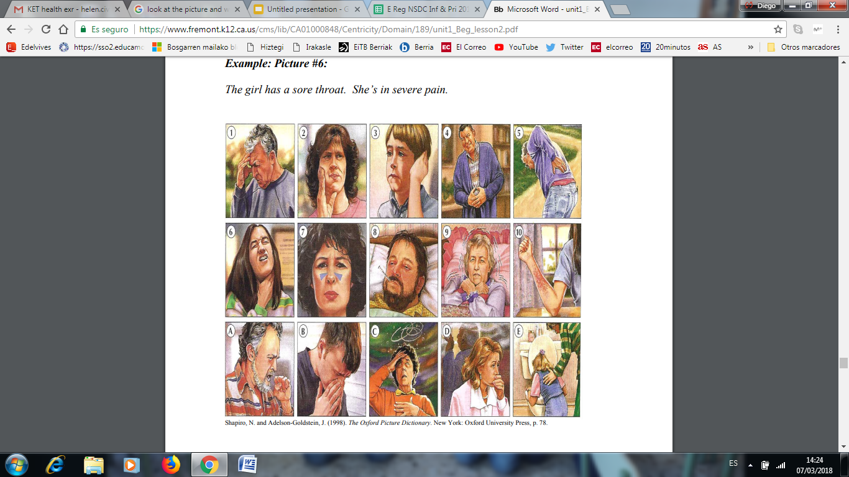
Look at the pictures below. Choose 5 and talk about them. Describe the symptoms and how each person feels

Slide 15
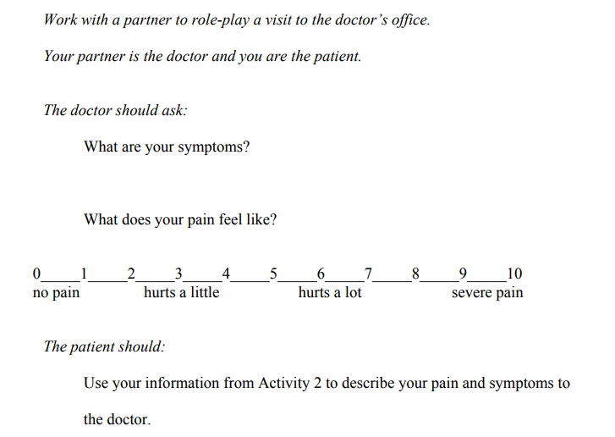

Slide 16
